Slide 1

TELCO CUSTOMER CHURN
DATA SCIENCE BOOTCAMP DEMO DAY (18 July 2020)
Tung Fu Wei @ Forward School (March 2020 Cohort)

Slide 2
Telco Customer Churn[IBM Sample Data Sets]
Focused customer retention programs
Customer churn is one of the most important metrics for a growing business to evaluate.
It's important because it costs more to acquire new customers than it does to retain existing customers.
Objective:
Perform EDA on the dataset to find out any valuable insights
Predicting churn and find out the features that contributes to customer churn.
List of tools/technologies used in the project: Numpy, Pandas, Seaborn, Matplotlib, Scikit-Learn
https://www.kaggle.com/blastchar/telco-customer-churn

Slide 3

Data Overview
Target Label & Features
Customers who left within the last month – the column is called Churn
Services that each customer has signed up for – phone, multiple lines, internet, online security, online backup, device protection, tech support, and streaming TV and movies
Customer account information – how long they’ve been a customer, contract, payment method, paperless billing, monthly charges, and total charges
Demographic info about customers – gender, age range, and if they have partners and dependents

Slide 4

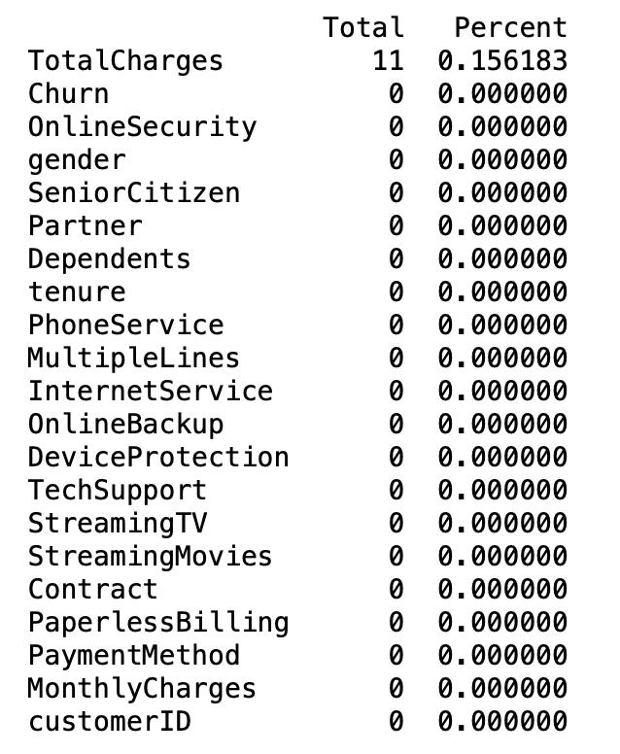
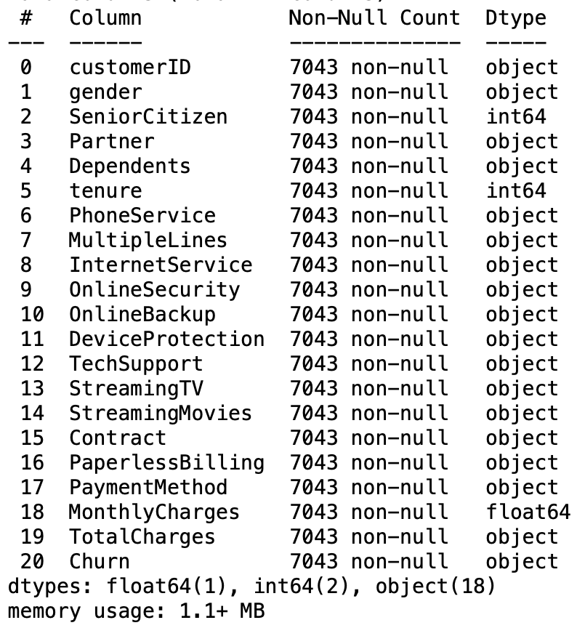
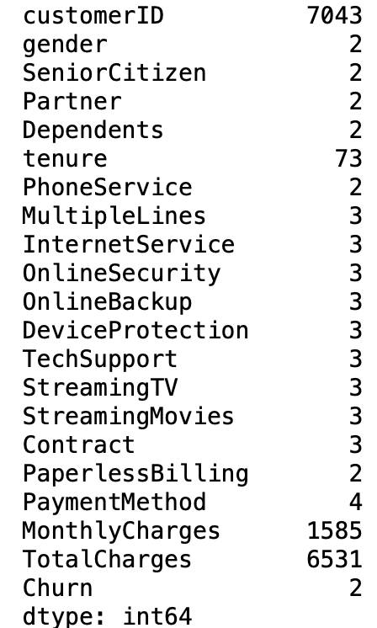
Data Wrangling
Handle missing data
Converting to float type(TotalCharges)
Drop unused columns(customerID)

Slide 5
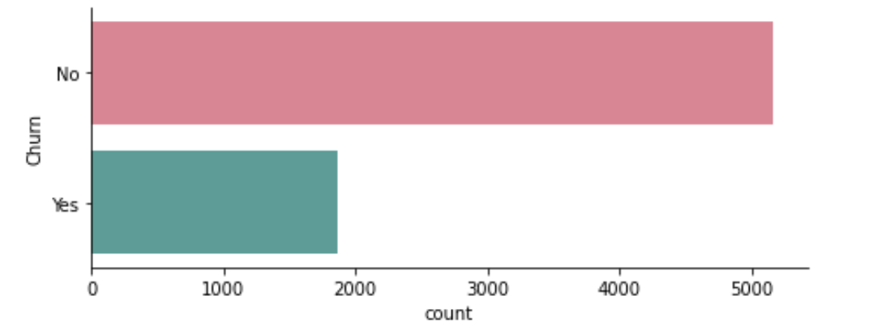
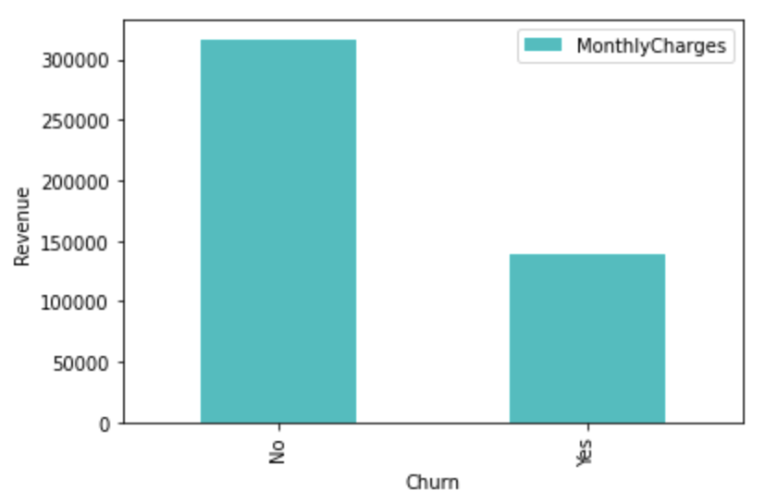
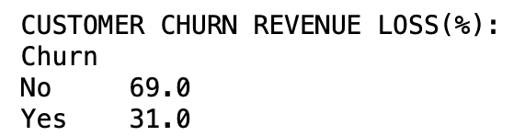
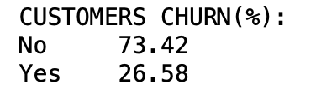
Exploratory Data Analysis (1)
Target Label: Churn
Churn Distribution
Churn vs Revenue Lost (%)

Slide 6
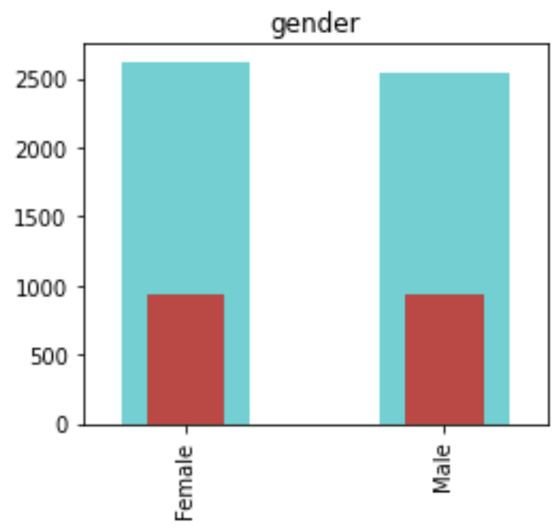
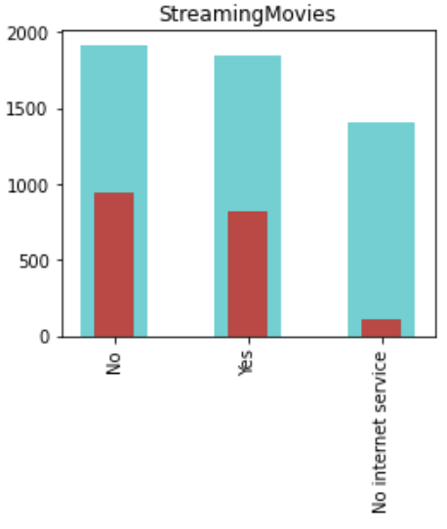
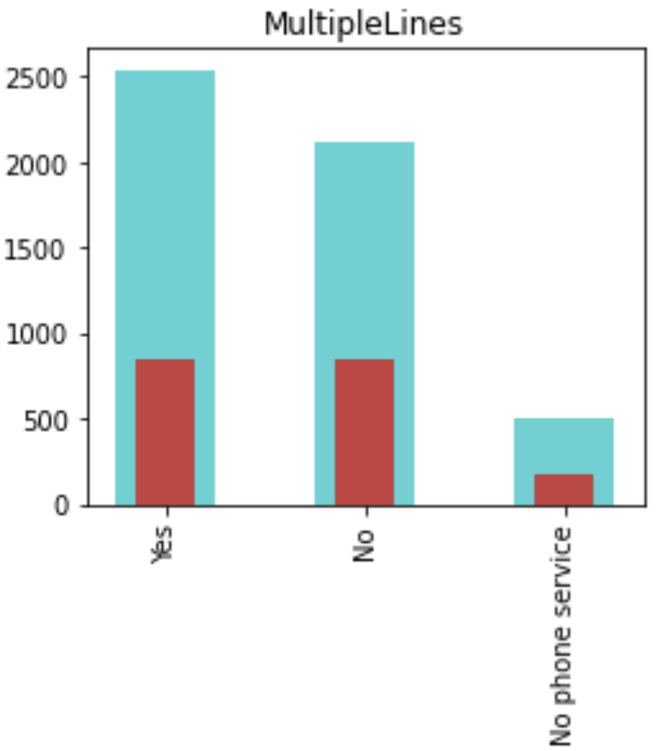
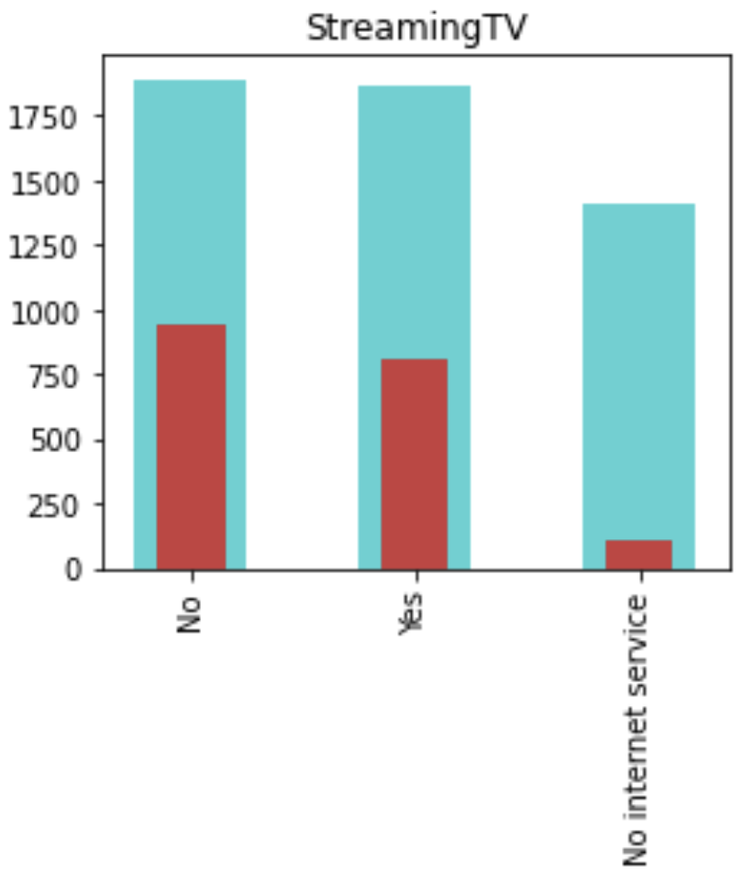
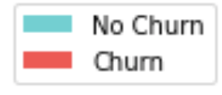
Exploratory Data Analysis (2)
Features: Categorical Features (not significant)
Gender
Streaming TV
Streaming Movie
Multiple Lines

Slide 7
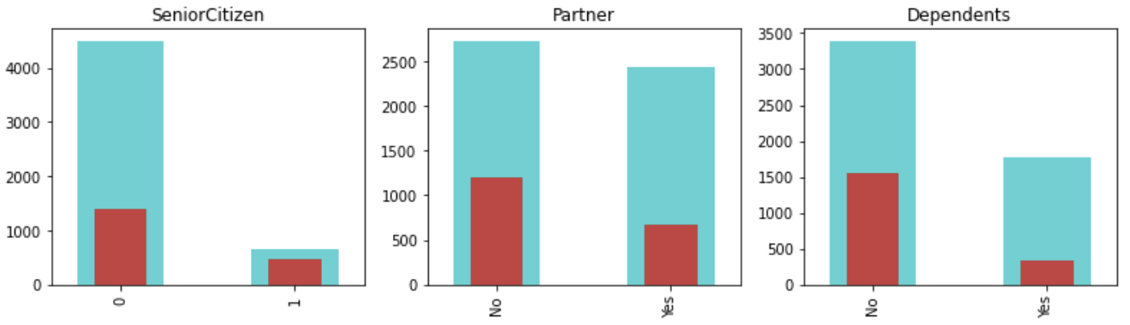
Exploratory Data Analysis (3)
Features: Categorical Features (significant)
Senior Citizen
Partner
Dependents

Slide 8
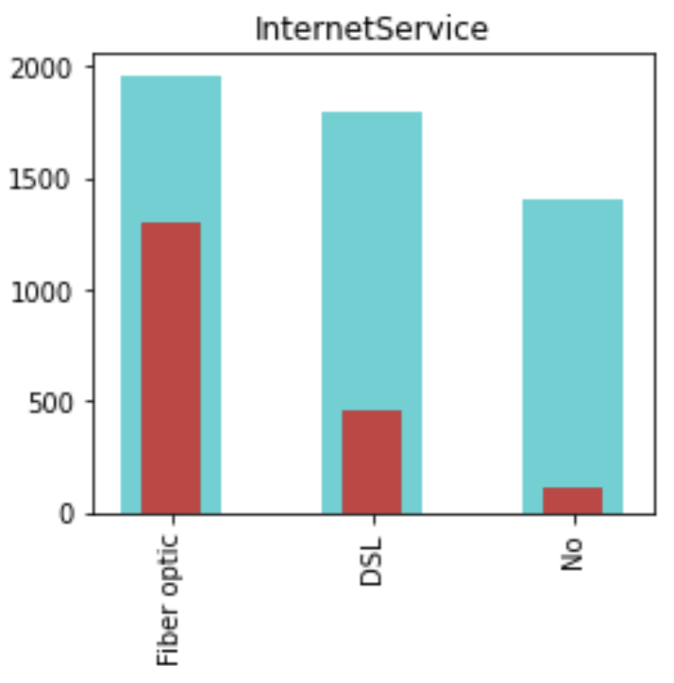
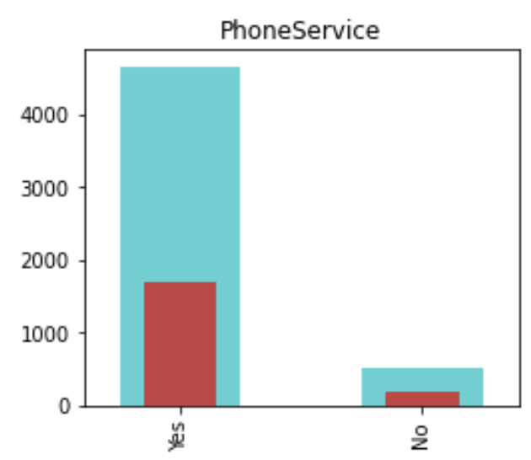
Exploratory Data Analysis (4)
Features: Categorical Features (significant)
Internet Service
Phone Service

Slide 9
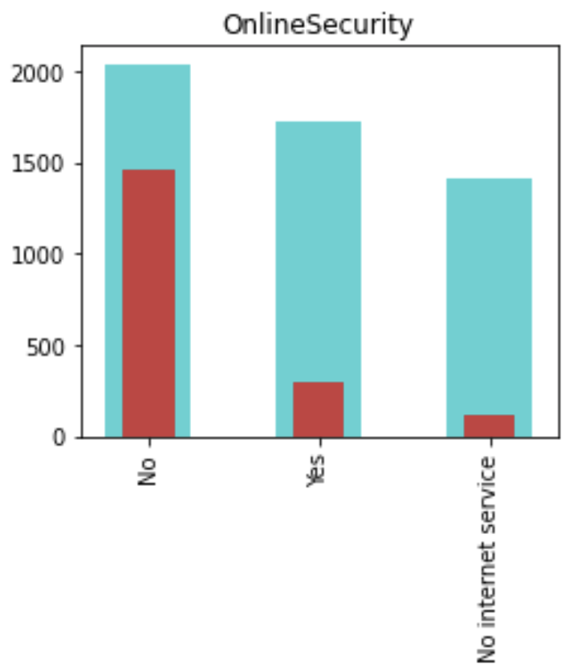
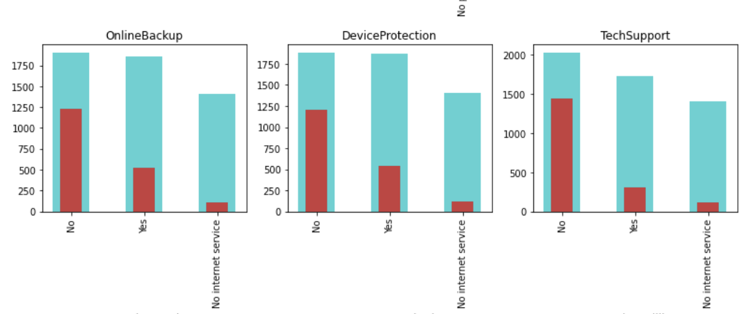
Exploratory Data Analysis (5)
Features: Categorical Features (significant)
Device Protection
Online Security
Online Backup
Tech Support

Slide 10
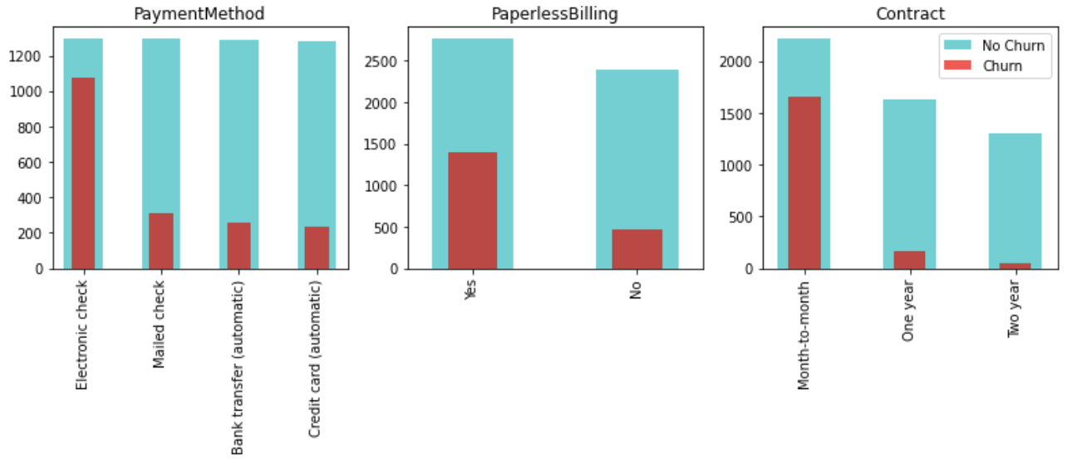
Exploratory Data Analysis (6)
Features: Categorical Features (significant)
Payment Method
Paperless Billing
Contract

Slide 11
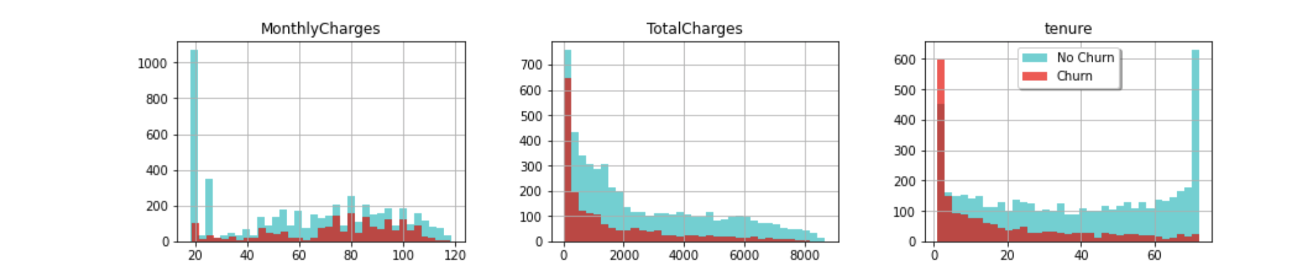
Exploratory Data Analysis(7)
Features: Numerical Features
Hist Plot

Slide 12
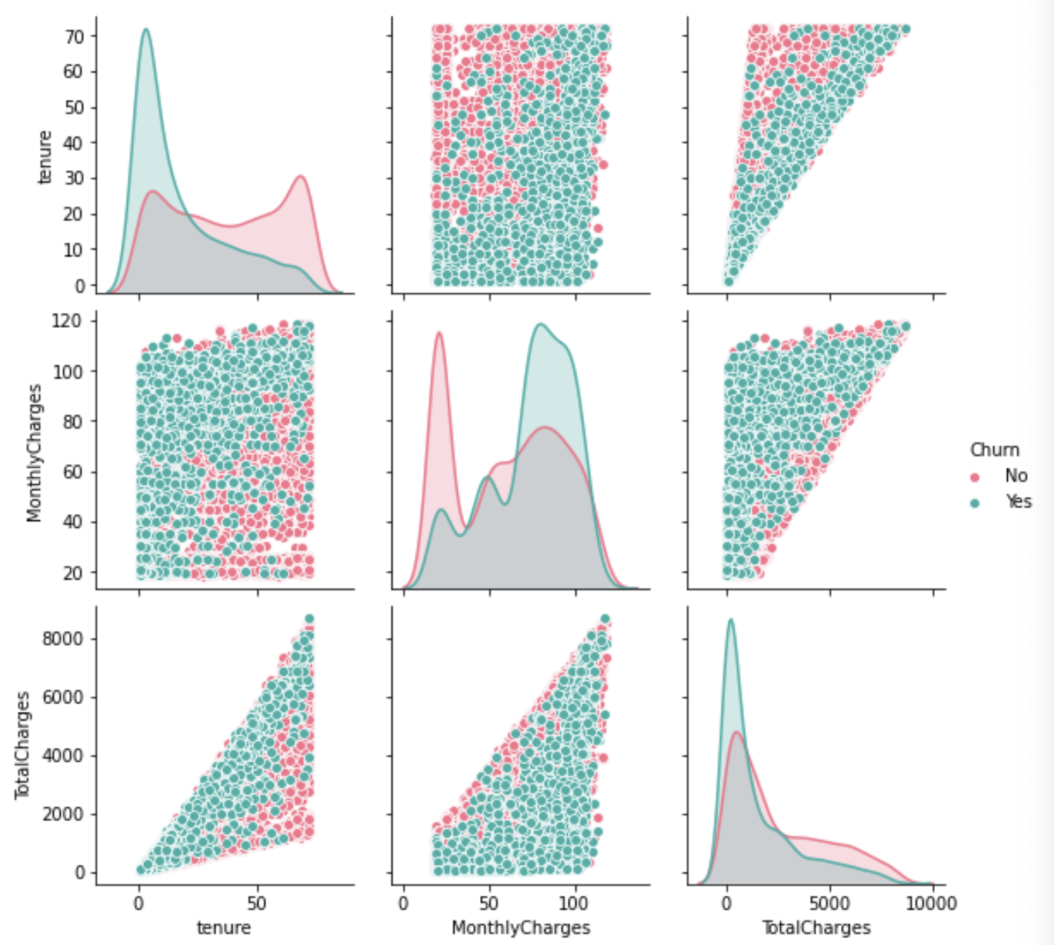
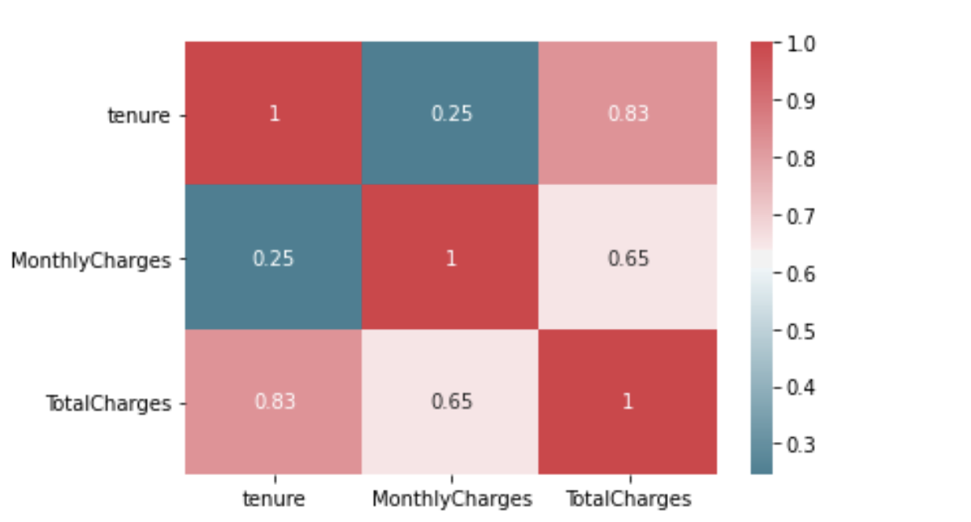
Exploratory Data Analysis(8)
Features: Numerical Features
Pair Plot
Heat Map

Slide 13
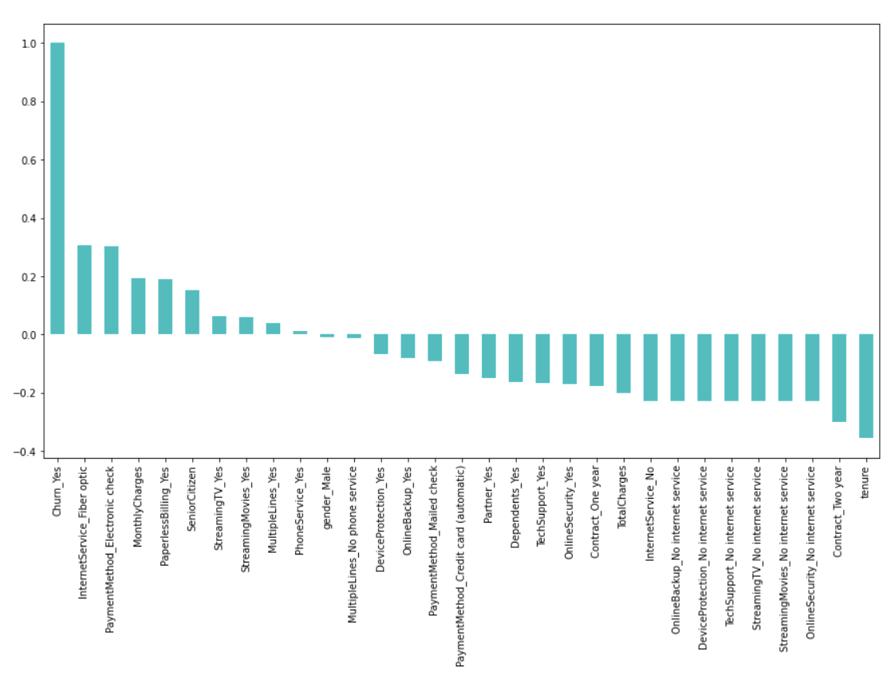
Data Preprocessing
#OneHotEncoder-Catergorical Features
#MinMaxscaler -Numerical Features
#train_test_split(test_size=0.3 , random_state=42)
1.InternetService_Fiber optic
2.PaymentMethod_Electronic check
3.Tenure
4.Contract_Two year

Slide 14
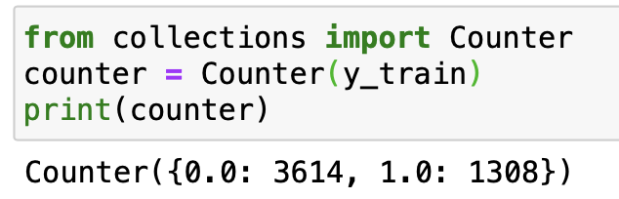
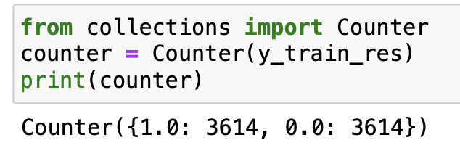
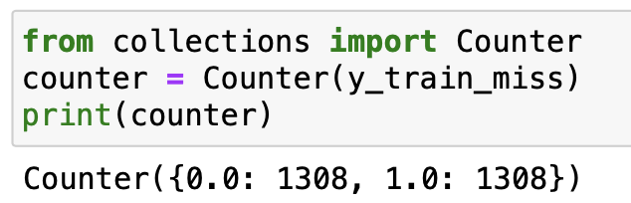
Imbalanced Dataset
#from imblearn.over_sampling import SMOTE
#from imblearn.under_sampling import NearMiss
Train Data
Train Data (SMOTE) - Up sampling(Minority)
Train Data (Near_Miss) - Down sampling(Majority)

Slide 15
Comparison between Algorithm
No. | Algorithm /Accuracy | Imbalanced | SMOTE | Near_Miss
1 | Logistic Regression | 0.802110 | 0.763150 | 0.590746
2 | XGBClassifier | 0.791747 | 0.846328 | 0.574626
3 | KNeighborsClassifier | 0.765741 | 0.789745 | 0.513467
4 | DecisionTreeClassifier | 0.739123 | 0.781842 | 0.536763
5 | RandomForestClassifier | 0.797847 | 0.853513 | 0.553232
6 | GradientBoostingClassifier | 0.803537 | 0.838160 | 0.578506
7 | RidgeClassifier | 0.799469 | 0.762322 | 0.581962
8 | BaggingClassifier | 0.779560 | 0.822647 | 0.551612
9 | ExtraTreeClassifier | 0.781999 | 0.871222 | 0.518495
10 | SVC | 0.800081 | 0.796501 | 0.535775
11 | GaussianNB | 0.67309 | 0.747822 | 0.661703
12 | AdaBoostClassifier | 0.800486 | 0.799271 | 0.592271
K-fold Cross Validation Technique
n=10

Slide 16
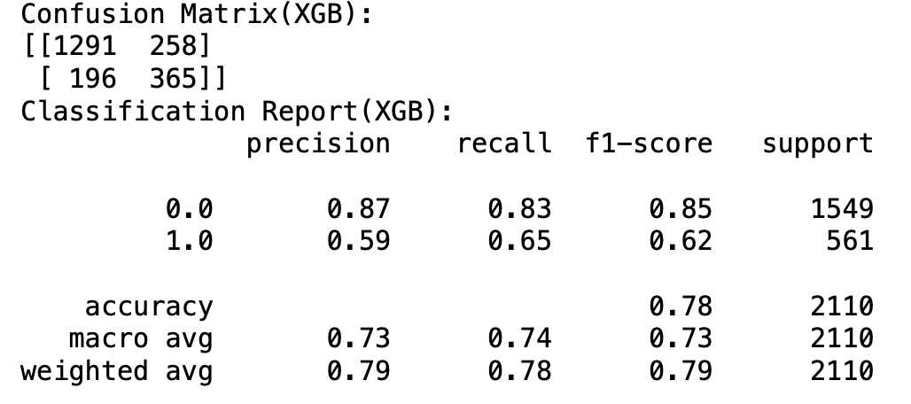
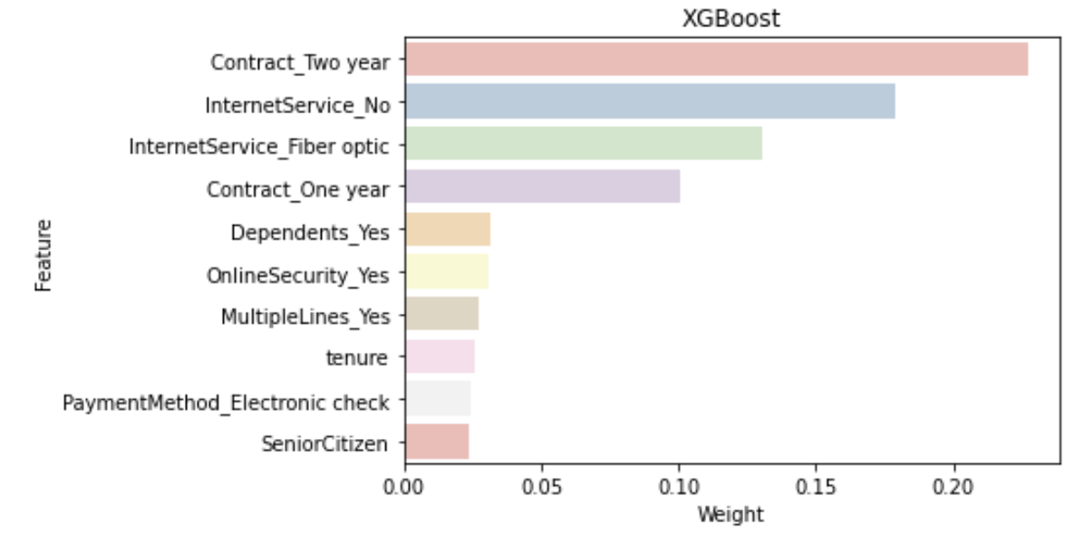
XGBoost (Precision = 59%)
n_estimators =100, max_depth=3, random_state=42

Slide 17
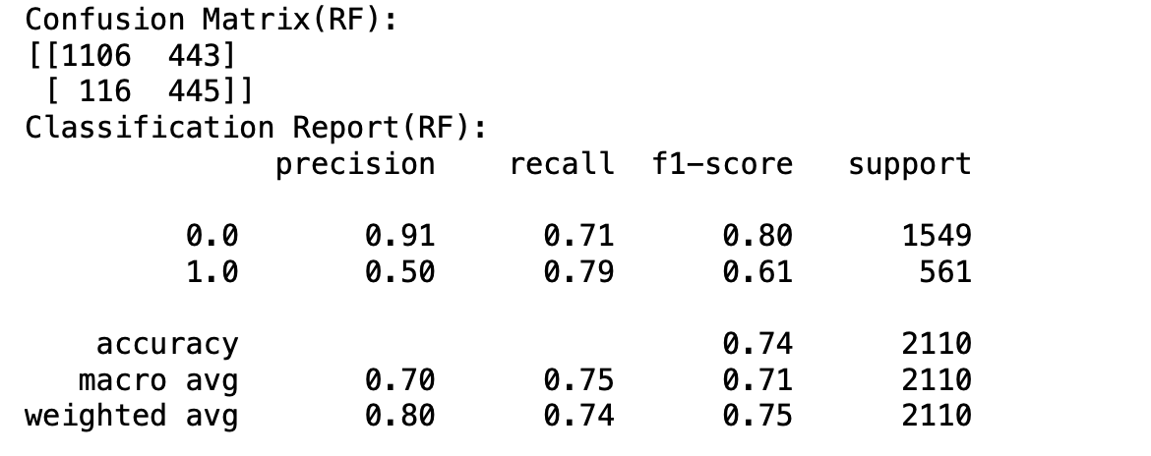
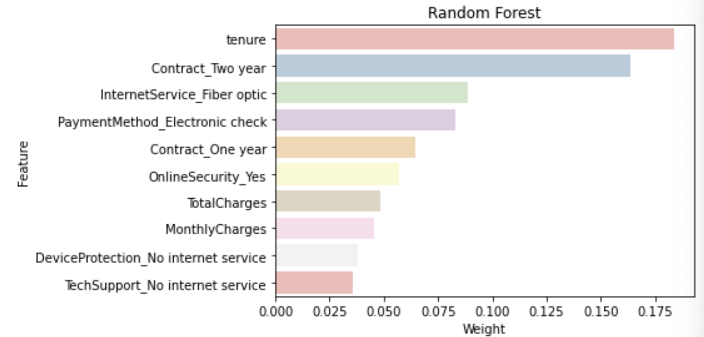
Random Forest (Precision= 50%)
n_estimators =100, max_depth=3, random_state=42

Slide 18
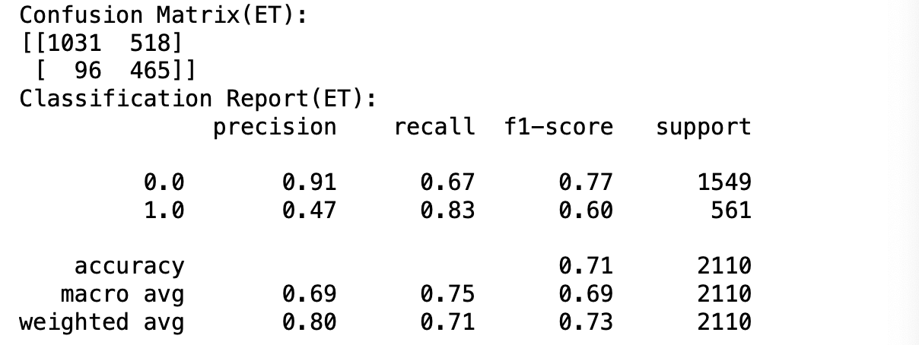
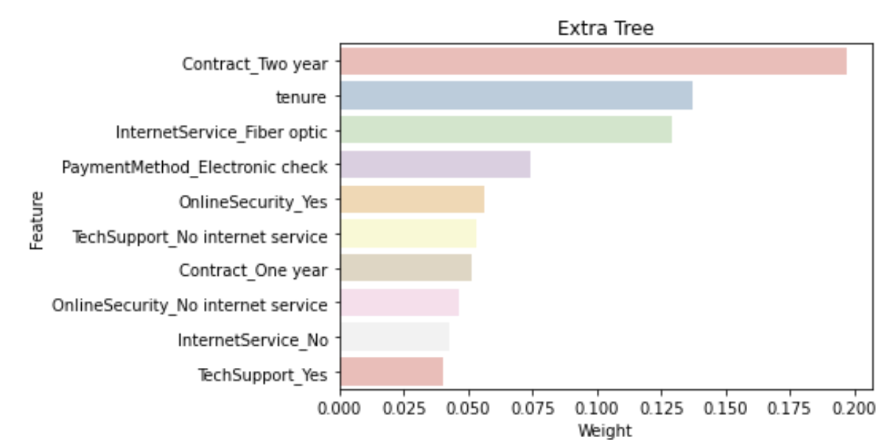
Extra Tree (Precision= 47%)
n_estimators =100, max_depth=3, random_state=42

Slide 19
Business Insights

Slide 20
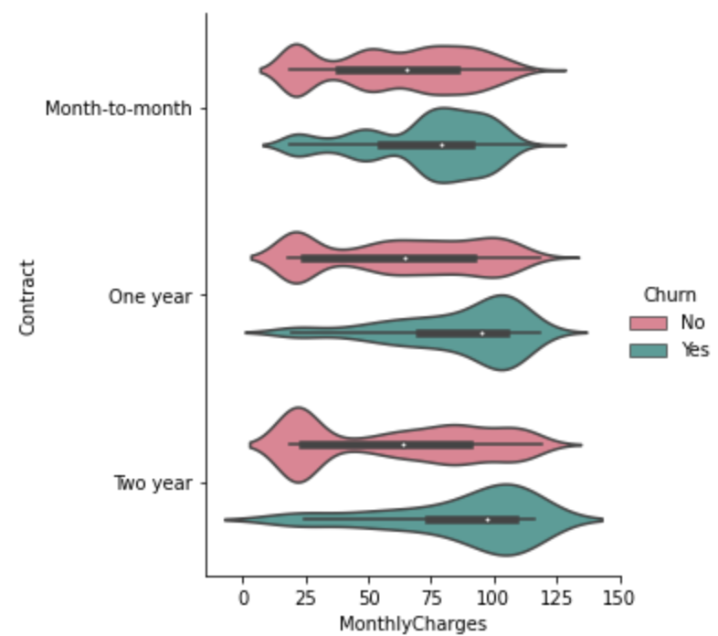
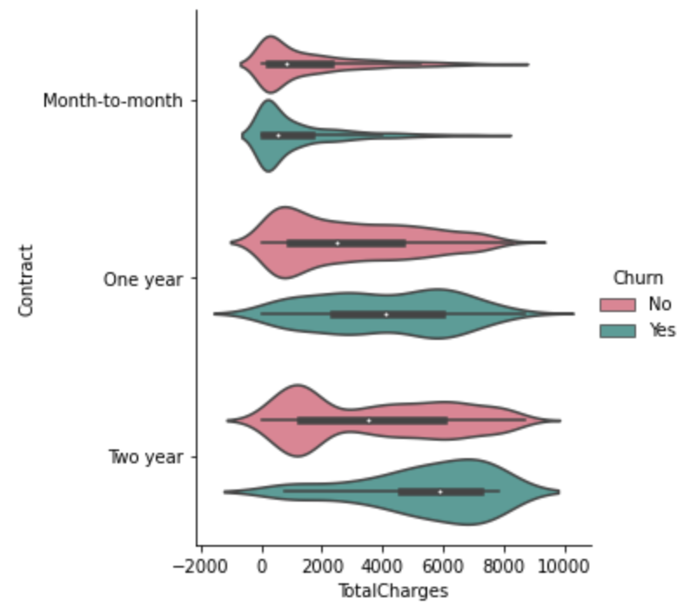
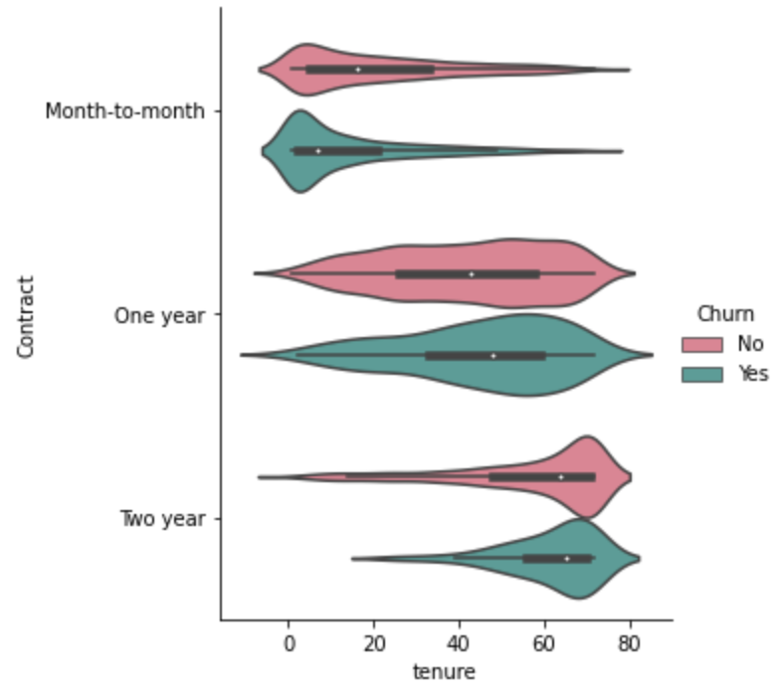
Contract Two Year

Slide 21
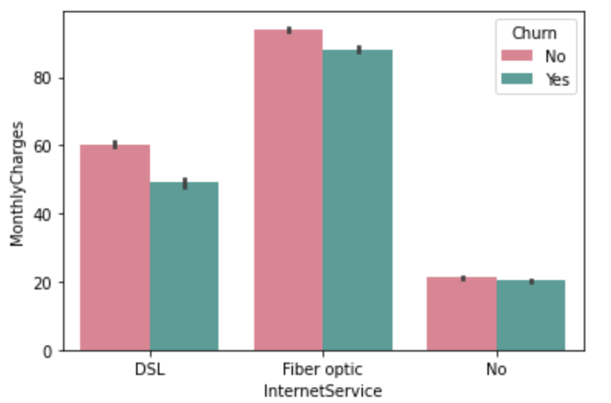
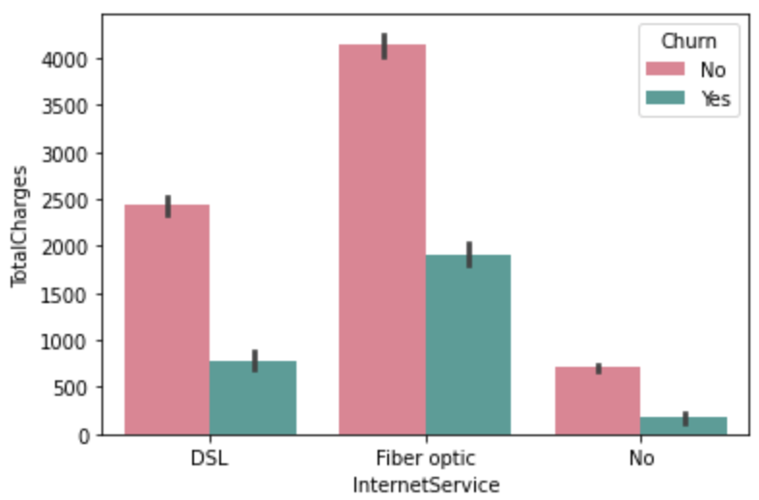
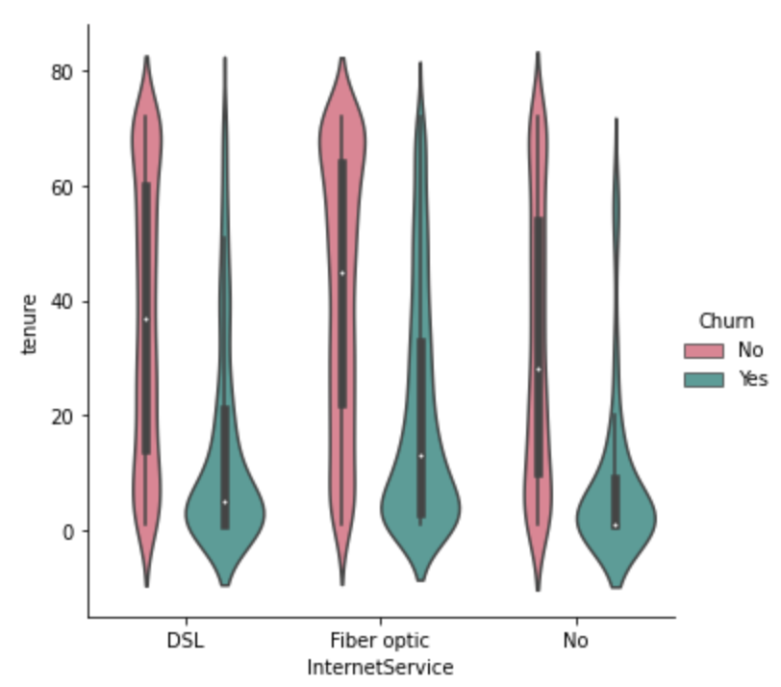
Internet Service Fiber Optic

Slide 22
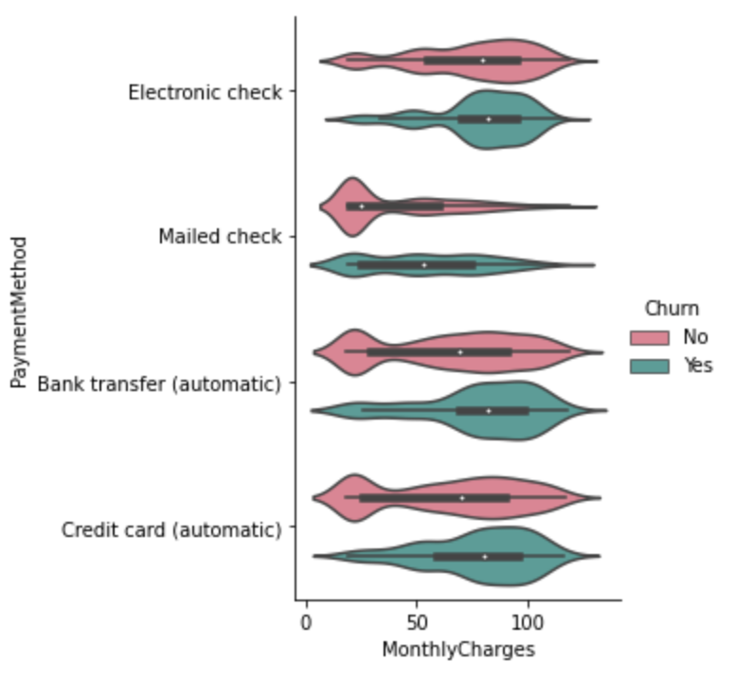
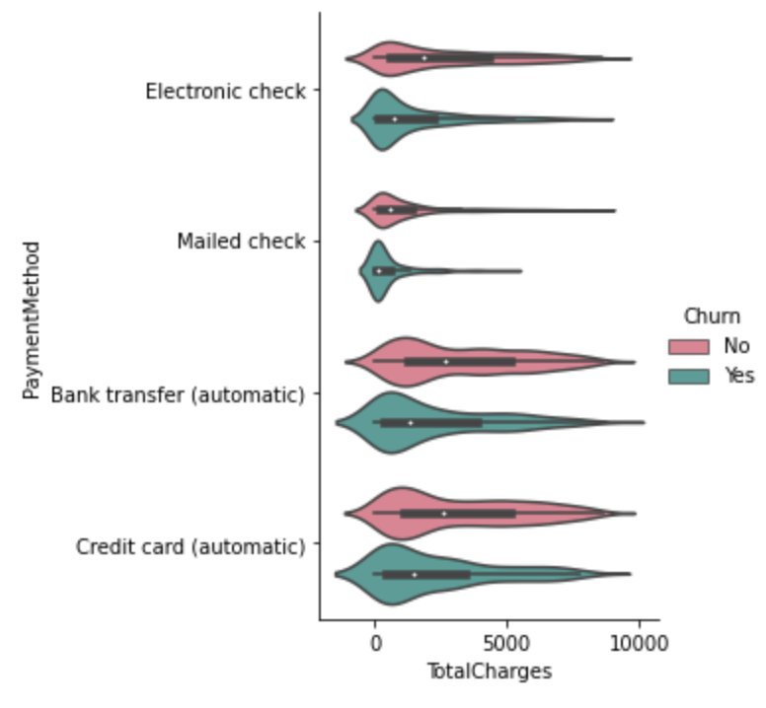
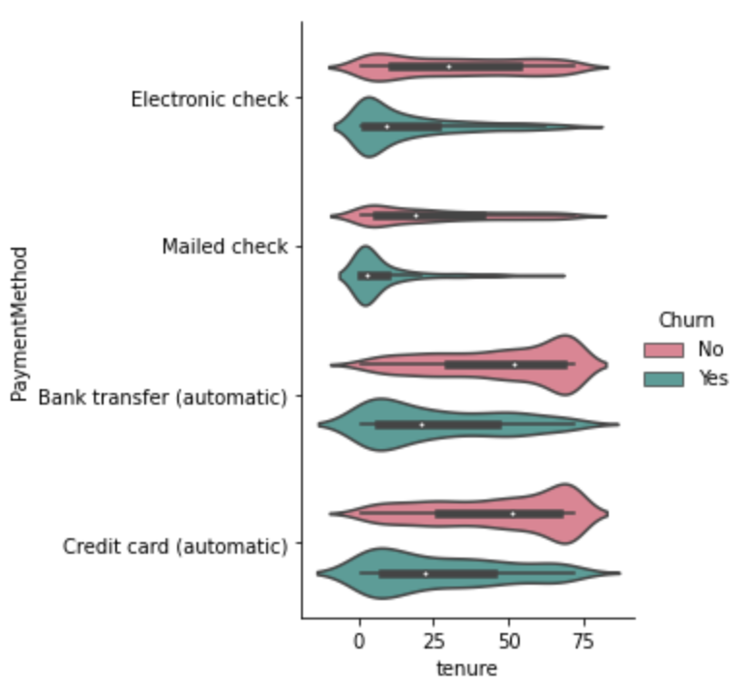
Payment Method Electronic Check

Slide 23


Slide 24


THANK YOU!
Tung Fu Wei
Phone:
018-9560388
Email:
tungfw@gmail.com

